Slide 1
Outline
Project and Task 1 Introduction
Data Review
Part Ranking
Dashboards
ER Diagram
Data Dictionary
Key Observations

Slide 2
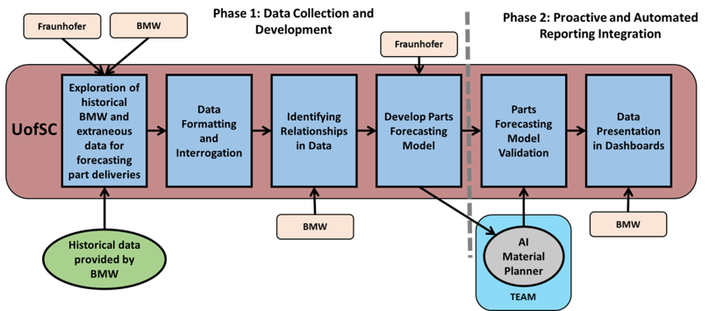
UofSC Roadmap

Slide 3
Task 1: Exploration of Data
Understand headers
Get information on quality, ordering times, transportation, etc.
Identify poor areas/gaps in data
Make timeline of orders
Define states (early, tardy, too late)
Calculate numbers for tangible and intangible criteria ​
Create supplier ranking
Integrate findings into deliverable document ​
Deliverable: key figures from historical data,
rich/poor areas, supplier ranking

Slide 4
Data Review: Reports
130, zgrve, MD04

Slide 5
Data Review: User Documentation
Material Master Planner
Summary
Key Points
Where all logistical data is stored and maintained
If not maintained, its impossible to create delivery schedules
Refer to when: There is unknown field or “view” information
Relevant Views- MRP1, MRP2, and Classification
P-S Status
Lot Size
Procurement
Scheduling
Net Requirement Calculations

Slide 6
Data Review: User Documentation
MC10/TS-12x
Summary
Key Points
Shows the process for changing the forecasted requirements at the single item, single level
Summary of general information
Refer to when: needing general information about processes or exception messages
Multiple Processes:
Reschedule and Order Proposal
Initial Pegged Requirements
General Info:
Dependent and Independent Requirements
Schedule Agreements
Purchase Requisitions
Planned Orders
Scrap % Requirements

Slide 7
Data Review: User Documentation
User Manual Bulk Planning Process
Summary
Key Points
Daily Tasks of planners
Covers a lot of what has been seen in the interviews
Refer to when: There are questions about the planning process/refreshing on interviews
Check A/B shift
Run Material Adjustment
Run MD07 SAP Transaction
Change Schedule per Exception Messages
Running MRP and Sending EDI Releases
Sending Zero Call Offs or Manually Creating Schedule Lines – AI Level Changes/Run Out Parts
Verifying XPLT Stock Movements

Slide 8
Data Review: Interviews
The team met with 4 material planners to understand their thought process while planning, data used, and how they address problems.
Material Planners
Ben Shockley
Jeffrey Griggs
Tashelle Brady
Liliana Banda
Interview Objectives
Familiarize ourselves with the Planner’s daily tasks and the processes used to assess risk and make decisions regarding material planning forecasting.
Identify features that planners commonly use
Identify what capabilities would be helpful in a dashboard
Identify logic of current SAP system

Slide 9
Part Ranking
A part ranking algorithm using Markov Chain is being developed
Based on historical data, we will be able to calculate the probability that an order will be early or late and by how many days for the next delivery.
Data Needed
Supplier number
Part number/description
Expected receipt date
Actual receipt date
Data Extracted From
Zgrve Reports
Material (part #)
Supplier #
GR date (actual receipt date)
MD04 Reports
Material
Demand_Date/”ShipNt” in MRP Element

Slide 10
Part Ranking: Data Usage
Part numbers are used to relate the information in the MD04 files and Zgrve reports
The expected date from MD04 is compared to the “goods receipt date” from Zgrve to obtain the difference in how many days late/early a part was delivered, and how often this happens (historical data)
This data is assumed to be a Markov chain and used to calculate long run probabilities of a supplier being early/late/on time and by how many days
Material # can be related to Supplier # to find out if a supplier is performing well or poorly across the board, or with specific parts

Slide 11
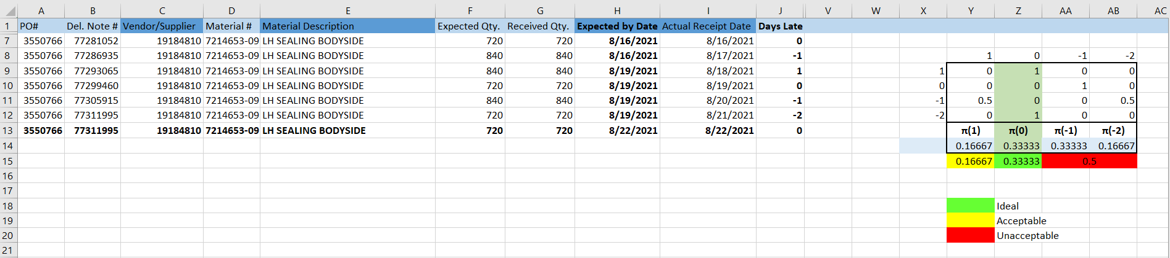
Part Ranking: Example
For this specific sample part (bolded fields were created randomly) the data shows there is a 16% chance this part will arrive one day early, 33% chance it will arrive on time, 33% chance it will arrive one day late, and 16% chance it will arrive two days late (50% chance of late arrival)
The more historical data there is available, the more accurate the ranking is
Suppliers will be ranked based on % chance of on time arrival

Slide 12
Part Ranking: Future Direction
Once underperforming parts have been identified, we can work on identifying the root cause
Quality of supplied parts is not up to standards
Supplier does not ship parts in time
Transportation provider does not deliver parts in time
Lead times are not calculated correctly
Weather delays during a certain season
Others
Identifying the cause for the delays and taking early action will help prevent them from happening in the future

Slide 13
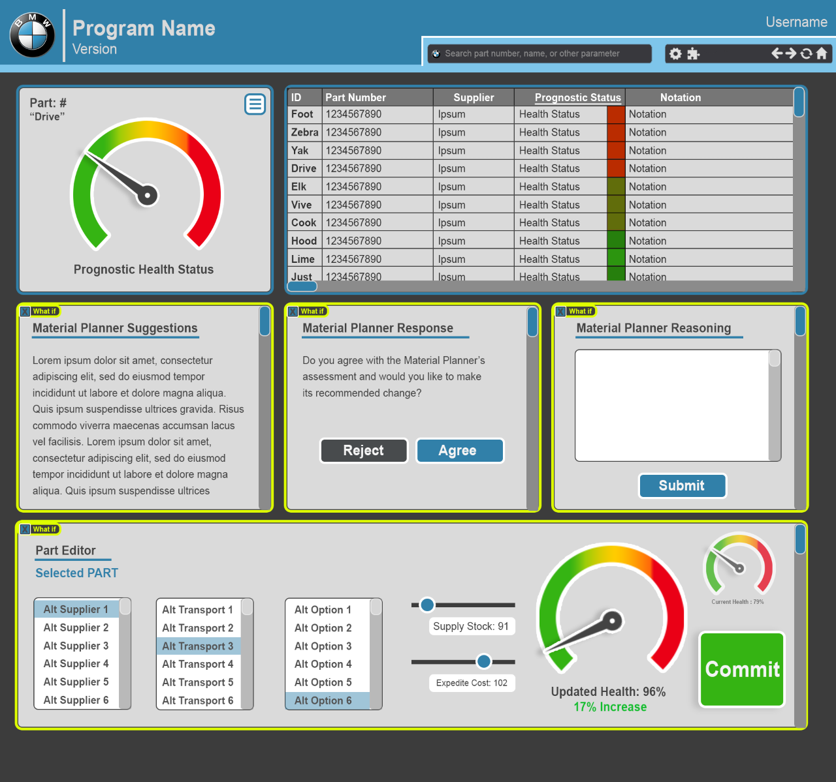
User Dashboards
The user dashboard will integrate all needed data and analysis into one location for the planner
The planner can view the status of their parts and a gauge will replace the stoplight to give a more exact representation.
The material planner suggestion will be displayed along with a box to collect the Planner’s feedback on why they accepted or rejected
The dashboard will also allow for creating “what if” scenarios based on alternative suppliers, transportation, stock, etc.

Slide 14
Dashboards: Future Direction
Based on the observations from the interviews and continued understanding of planner’s needs, we would like to address the following in future development of the dashboards.
Identify a way to streamline exception messages.
There is an immense amount of “gut feeling” here, to address this, the front-end can be designed to maximize the quantification and qualification of machine learning on the back end.
There seems to be an issue with standardization. We can tailor the front end to populate the backend, working to standardize it without interrupting user experience. A lot of this will come down to creating a system to allow for quick documentation of “gut feeling.”
Asynchronous timers could be leveraged in a way they are not currently. It seems that some things are ‘put off until they can be dealt with’ and we can find better ways to manage these sorts of extraneous things

Slide 15
Initial ER Diagram

Slide 16

0 %
100 %
Material Planner
Plant
Supplier
Health
Status
Dashboard
Material
Planner
has
1..*
Supplier
(Vendor)
recommend
Responsible
supply
Supply
use
Output
1..*
Material
Planning
has
Material
(Part)
input
Material Inventory
input
Material Trans.
use
Material Config.
generate
Exception
Exception

Slide 17
Data Dictionary for Material Planner
Objectives
Identify most important columns for Material Planner
Identify columns that can be imported from Parts DB
Identify columns that can be generated by Reco. Engine and Forecast Model
Data Dictionary Schema
Example
Column | Possible Value
Name
Type | Text/Number/Date
Description
Source | Material Planner (or Part DB)/Algorithm
Frequency of change | High/Low/None
Purpose | Forecast Model, Reco. Dashboard, What..if
Column | Possible Value
SafetyStck
Type | Number
Description | …
Source | Material Planner (or Part DB)
Frequency of change | Low
Purpose | Forecast Model, Reco. Dashboard, What..if

Slide 18
Material Planner
MRPCn (PK)
Planner Name
Vendor ID (FK)
Material Transaction
Material ID (FK)
Plant ID (FK)
MRPCn (FK)
Vendor ID (FK)
Shipment ID (FK)
Demand Date (Date, TimeStamp)
MRP Element (Text, category)
Change Qty (number, Qty)
Total Qty (number, Qty)
Supply
Shipment ID (PK)
Material ID (FK)
Vendor ID (FK)
Purchase Order #
Trailer ID (number, Key)
Source of Shipment (Lat., Lng, Address)
Dest. of Shipment (Lat., Lng, Address)
ETA to Dest. (number, hrs.)
Supply TS (Date, TimeStamp)
Material Planner
KPI
Material Config.
Material ID (PK)
Material Desc
Safety Stock (number, Qty)
Planning Time Fence
Safety Time
Planning Calendar
Dashboard
Material ID (FK)
Health Status (number , 0-100 in %)
Stock DoS (number, in Days)
First Receipt DoS (number, in Days)
Exception ID (FK)
?
?
Plant
Plant ID (PK)
Plant Location
MRP Area
Supplier
Vendor ID (PK)
Vendor Name
Material ID (FK)
Exception
Exception ID (PK)
Exception Msg

Slide 19
MRP Element Possible Values
MRP Element | Description
Stock | An Initial stock value
DepReq | It specifies requirement/demand/consumption of a part.
ShipNt | Number of stck in transit; The trailer which is carrying the parts is in transit. It is expected to be at the delivery location on a demand date.
SchAgr | The quantity of stck we are expecting to collect from a supplier. It will be delivered on a demand date.
IndReq | Order Forecast of stock
SafeSt | It specifies the quantity whose purpose is to satisfy unexpectedly high demand in coverage period. The risk of shortfalls is reduced by having a safety stock.

Slide 20
Key Observations

Slide 21
Supporting Material

Slide 22
Interview Summary: Jeffrey Griggs 9 years at BMW, 20 years in Automotive Industry
Few EO’s -> Logical Planner
Doesn’t look at traffic lights/exception messages- looks at lowest coverage days and MRP/Inventory discrepancies first
Running behind schedule- notifies to push parts out
Ignore, unless weather, known line-shutdown, or Alfred says to not ignore
Rounding value- layer quantity on a palette, minimum order quantity (ASN Project?)
Dependent Vs Independent Requirements
Dependent -actual orders
Independent- more of a forecast, numbers appear more stable in SAP as a result
Semi Conductor Parts- changes very frequently due to availability of parts
Production runs ahead during the week and stops early Saturday
Time Fence
No hard answer for calculating, varies by planner
Keep close as possible to pickup days, too far out can lead to running out of parts
Planned delivery Time < Actual Coverage < Lead Time from Supplier

Slide 23
Interview Summary: Tashelle Brady 25 years experience
Planner for local suppliers and suppliers from Mexico, local can do same day delivery
Overall Approach- Let the system plan, then evaluate exceptions
Is it reasonable? Will it disrupt anything else? (Especially when stock is low).
Looks at exception messages first
Organize MRP numbers by vendor, haul, and source (bulk, JIT, etc)
Re-runs MRP to accept changes and check for gaps of “high-runners”
Exception messages in Time Fence: Ignored. Exceptions outside the Time Fence: let MRP system replan
Inputs safety stock when:
It’s cheaper than expediting in future
Doesn’t take up much space
Is high-quality
Almost never pushes supply, except for:
Short-term emergency
Level-loading
What would be helpful:
Automatic run of MRP after 2am, before any planning the next day
No one day pickups for suppliers in Mexico -> split into two to prevent EO or loss

Slide 24
Interview Summary: Liliana Banda ~3 years at BMW Material Planning
Planner for parts from Mexico
PTA is for rescheduling lines, EO is for extra inventory/new lines
Safety Stock:
For “low runners”
Material Planner sets safety lead time

Slide 25
Interview Summary: Ben Shockley 4 years as Material Planner, 19 years at BMW

Slide 26
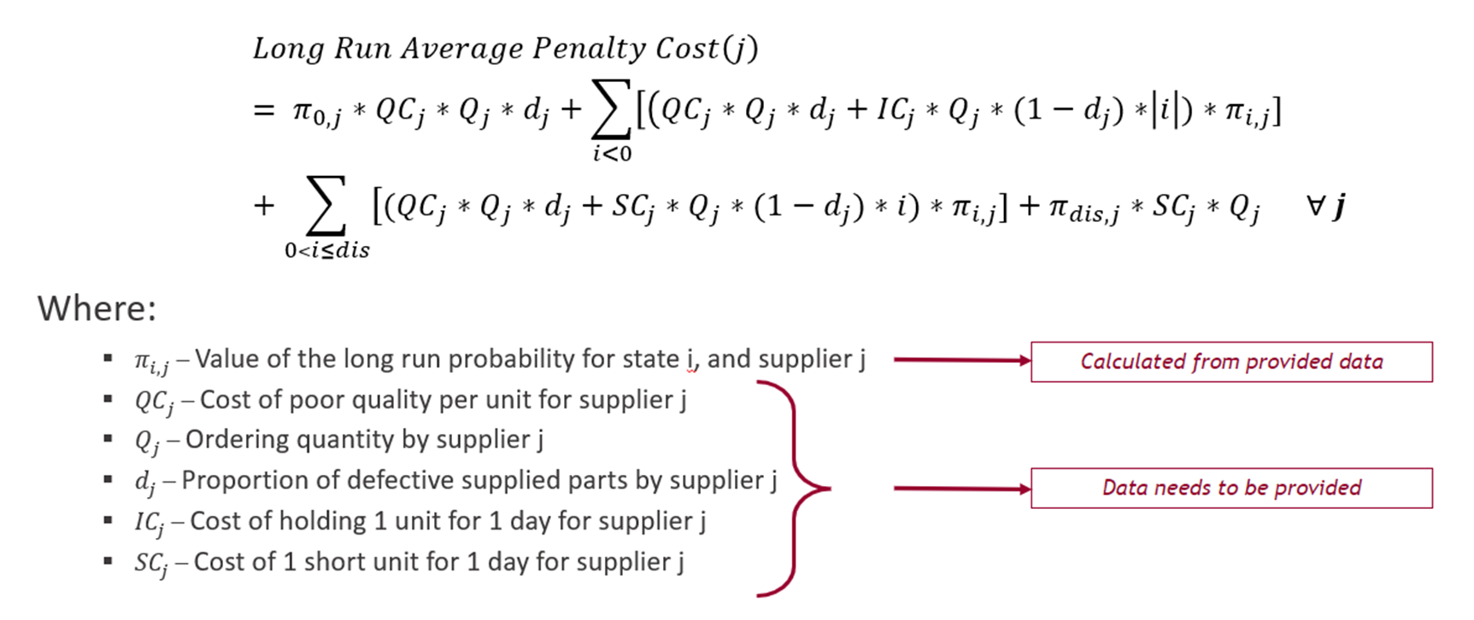
Part Ranking: Improvements
This will allow to calculate the monetary value a supplier represents
The lower the long run cost, the better the supplier is performing

Slide 27
Material Planner
MRPCn (PK)
Planner Name
Vendor ID (FK)
Material Transaction
Material ID (FK)
Plant ID (FK)
MRPCn (FK)
Vendor ID (FK)
Shipment ID (FK)
Demand Date (Date, TimeStamp)
MRP Element (Text, category)
Change Qty (number, Qty)
Total Qty (number, Qty)
Supply
Shipment ID (PK)
Material ID (FK)
Vendor ID (FK)
Purchase Order #
Trailer ID (number, Key)
Source of Shipment (Lat., Lng, Address)
Dest. of Shipment (Lat., Lng, Address)
ETA to Dest. (number, hrs.)
Supply TS (Date, TimeStamp)
Material Planner
KPI
Material Config.
Material ID (PK)
Material Desc
Safety Stock (number, Qty)
Planning Time Fence
Safety Time
Planning Calendar
Dashboard
Material ID (FK)
Health Status (number , 0-100 in %)
Stock DoS (number, in Days)
First Receipt DoS (number, in Days)
Exception ID (FK)
?
?
Plant
Plant ID (PK)
Plant Location
MRP Area
Supplier
Vendor ID (PK)
Vendor Name
Material ID (FK)
Exception
Exception ID (PK)
Exception Msg

Slide 28
Material Planner
MRPCn (PK)
Planner Name
Vendor ID (FK)
Material Transaction
Material ID (FK)
Plant ID (FK)
MRPCn (FK)
Vendor ID (FK)
Shipment ID (FK)
Demand Date (Date, TimeStamp)
MRP Element (Text, category)
Change Qty (number, Qty)
Total Qty (number, Qty)
Supply
Shipment ID (PK)
Material ID (FK)
Vendor ID (FK)
Purchase Order #
Trailer ID (number, Key)
Source of Shipment (Lat., Lng, Address)
Dest. of Shipment (Lat., Lng, Address)
ETA to Dest. (number, hrs.)
Supply TS (Date, TimeStamp)
Material Planner
KPI
Material Config.
Material ID (PK)
Material Desc
Safety Stock (number, Qty)
Planning Time Fence
Safety Time
Planning Calendar
Dashboard
Material ID (FK)
Health Status (number , 0-100 in %)
Stock DoS (number, in Days)
First Receipt DoS (number, in Days)
Exception ID (FK)
?
?
Plant
Plant ID (PK)
Plant Location
MRP Area
Supplier
Vendor ID (PK)
Vendor Name
Material ID (FK)
Exception
Exception ID (PK)
Exception Msg

Slide 29
Material Planner
MRPCn (PK)
Planner Name
Vendor ID (FK)
Material Transaction
Material ID (FK)
Plant ID (FK)
MRPCn (FK)
Vendor ID (FK)
Shipment ID (FK)
Demand Date (Date, TimeStamp)
MRP Element (Text, category)
Change Qty (number, Qty)
Total Qty (number, Qty)
Supply
Shipment ID (PK)
Material ID (FK)
Vendor ID (FK)
Purchase Order #
Trailer ID (number, Key)
Source of Shipment (Lat., Lng, Address)
Dest. of Shipment (Lat., Lng, Address)
ETA to Dest. (number, hrs.)
Supply TS (Date, TimeStamp)
Material Planner
KPI
Material Config.
Material ID (PK)
Material Desc
Safety Stock (number, Qty)
Planning Time Fence
Safety Time
Planning Calendar
Dashboard
Material ID (FK)
Health Status (number , 0-100 in %)
Stock DoS (number, in Days)
First Receipt DoS (number, in Days)
Exception ID (FK)
?
?
Plant
Plant ID (PK)
Plant Location
MRP Area
Supplier
Vendor ID (PK)
Vendor Name
Material ID (FK)
Exception
Exception ID (PK)
Exception Msg

